Slide 1
MOTORS

Slide 2
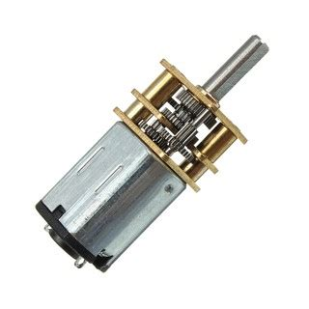
G12-N20 Geared Mini DC Motor
-Medium Power MP: 0.5W Max.
Rated Voltage: 6~12V.
5V -12V
300 RPM
Brushed contacts.
Relatively Cheap

